Slide 1
Computer Architecture Concepts
Part 17 – MIPS System calls

Slide 2
Objectives
Consider the need for calling the operating system
Call the operating system from a MIPS Assembly language program to:
Print an integer to the console
Print a character to the console

Slide 3
Operating systems
Programs need to communicate with user
Need to get input data (e.g. from keyboard)
Need to output data (e.g. to screen)
The operating system is at the level between the program and the hardware
The operating system will provide services such as input and output
We don’t cover operating systems on this unit
In our programs we need to request services from the operating system
In MIPS we do this through System Calls (syscall)

Slide 4
MIPS syscall
MIPS instruction set has syscall instruction to pass control to the operating system
The syscall instruction itself has no parameters (unlike add)
The information to the operating system must be set up in specific registers before using the syscall instruction
Value in register $v0 tells the operating system what action to do
Additional information is usually in register $a0
Control temporally switches to OS to perform the service before program resumes
Syscalls are expensive in time

Slide 5
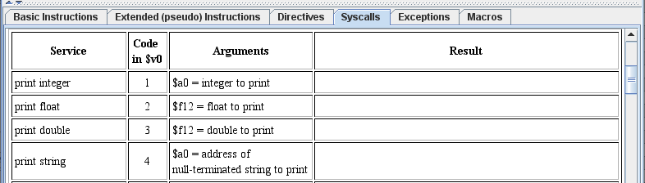
Viewing Syscalls available in MARS
Click help and then the Syscalls tab
It tells us what to put in register $v0 and in $a0
For example, to print an integer
Put 1 in $v0
Put the integer to print in $a0

Slide 6
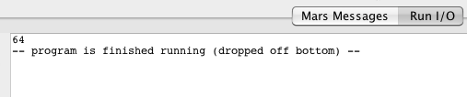
Example: print 64 to console
#Put 1 in $v0
addi $v0, $zero, 1
#Put 64 in $a0
addi $a0, $zero, 64
#Pass Control to OS
syscall

Slide 7
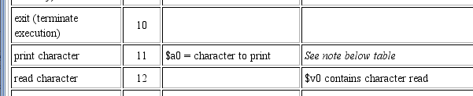
Printing a single character
Section of help for Syscalls shown below
To print a character
Put 11 in $v0
Put the character to print in $a0 (use single quotes or a number)
It will print the ASCII character corresponding to the low-order byte given in $a0

Slide 8
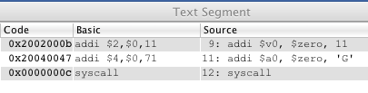

Example: print the letter G
#Put 11 in $v0
addi $v0, $zero, 11
#Put G into $a0
addi $a0, $zero, 'G'
syscall
After assembling the program – note that the ASCII code for G is 71 in decimal (47 in hex)

Slide 9
Example: print the letter G
These two programs also print G to the console
#Put 11 in $v0
addi $v0, $zero, 11
#Put G into $a0
addi $a0, $zero, 71
syscall
#Put 11 in $v0
addi $v0, $zero, 11
#Put G into $a0
addi $a0, $zero, 0x47
syscall

Slide 10
Summary
Operating System Provides I/O
Use syscall instruction to pass control to OS
Tell OS what services you want performed via the $v0 Register
Additional information can also be passed to OS e.g. via $a0

